Slide 1
HMAC, CMAC
This lecture is mainly based on the power point slides by Professor Lawrie Brown.
Notes:
Zili Shao

Slide 2
Message Authentication Requirements
1. Disclosure
  Release of message contents to any person or process not possessing the appropriate cryptographic key
2. Traffic analysis
  Discovery of the pattern of traffic between parties
3. Masquerade
  Insertion of messages into the network from a fraudulent source
4. Content modification
  Changes to the contents of a message, including insertion, deletion, transposition, and modification
5. Sequence modification
  Any modification to a sequence of messages between parties, including insertion, deletion, and reordering
6. Timing modification
  Delay or replay of messages
7. Source repudiation
  Denial of transmission of message by source
8. Destination repudiation
  Denial of receipt of message by destination
1, 2: Message Confidentiality; 3, 4 ,5, 6: Message Authentication (Message Integrity)
7: Digital signature; 8. A combination of the use of digital signature and a protocol
Notes:
Message Authentication Code: (1) The receiver is assured of the integrity of the message. (2) The receiver is assured that the message is coming from the alleged sender.
In the context of communications across a network, the following attacks can be identified.
1. Disclosure: Release of message contents to any person or process not possessing the appropriate cryptographic key.
2. Traffic analysis: Discovery of the pattern of traffic between parties. In a connection-oriented application, the frequency and duration of connections could
be determined. In either a connection-oriented or connectionless environment, the number and length of messages between parties could be determined.
3. Masquerade: Insertion of messages into the network from a fraudulent source. This includes the creation of messages by an opponent that are purported to
come from an authorized entity. Also included are fraudulent acknowledgments of message receipt or nonreceipt by someone other than the message recipient.
4. Content modification: Changes to the contents of a message, including insertion, deletion, transposition, and modification.
5. Sequence modification: Any modification to a sequence of messages between parties, including insertion, deletion, and reordering.
6. Timing modification: Delay or replay of messages. In a connection-oriented application, an entire session or sequence of messages could be a replay of
some previous valid session, or individual messages in the sequence could be delayed or replayed. In a connectionless application, an individual message
(e.g., datagram) could be delayed or replayed.
7. Source repudiation: Denial of transmission of message by source.
8. Destination repudiation: Denial of receipt of message by destination.
Measures to deal with the first two attacks are in the realm of message confidentiality and are dealt with in Part One. Measures to deal with items (3) through (6)
in the foregoing list are generally regarded as message authentication. Mechanisms for dealing specifically with item (7) come under the heading of digital signatures.
Generally, a digital signature technique will also counter some or all of the attacks listed under items (3) through (6). Dealing with item (8) may require a combination
of the use of digital signatures and a protocol designed to counter this attack.
In summary, message authentication is a procedure to verify that received messages come from the alleged source and have not been altered. Message authentication
may also verify sequencing and timeliness. A digital signature is an authentication technique that also includes measures to counter repudiation by the source.

Slide 3
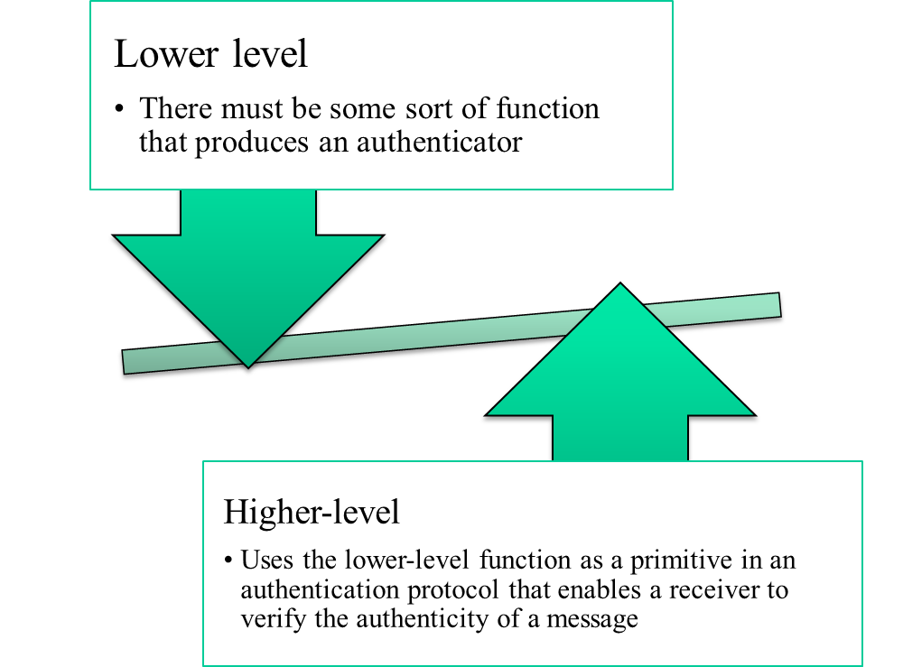
Message Authentication Functions
Two levels of functionality:
  Hash function
  A function that maps a message of any length into a fixed-length hash value which serves as the authenticator
  Message encryption
  The ciphertext of the entire message serves as its authenticator
  Message authentication code (MAC)
  A function of the message and a secret key that produces a fixed-length value that serves as the authenticator
Notes:
Message Authentication Code: (1) The receiver is assured of the integrity of the message. (2) The receiver is assured that the message is coming from the alleged sender.
Any message authentication or digital signature mechanism has two levels of functionality. At the lower level, there must be some sort of function that produces
an authenticator: a value to be used to authenticate a message. This lower-level function is then used as a primitive in a higher-level authentication protocol that
enables a receiver to verify the authenticity of a message.
This section is concerned with the types of functions that may be used to produce an authenticator. These may be grouped into three classes.
• Hash function: A function that maps a message of any length into a fixed-length hash value, which serves as the authenticator
• Message encryption: The ciphertext of the entire message serves as its authenticator
• Message authentication code (MAC): A function of the message and a secret key that produces a fixed-length value that serves as the authenticator
Hash functions, and how they may serve for message authentication, are discussed in Chapter 11. The remainder of this section briefly examines the remaining
two topics. The remainder of the chapter elaborates on the topic of MACs.

Slide 4
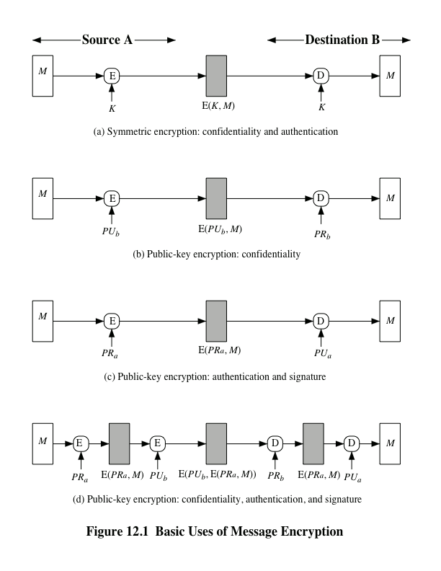
Notes:
Message Authentication Code: (1) The receiver is assured of the integrity of the message. (2) The receiver is assured that the message is coming from the alleged sender.
Consider the straightforward use of symmetric encryption (Figure 12.1a). A message M transmitted from source A to destination B is encrypted using a secret key K shared by A and B.
If no other party knows the key, then confidentiality is provided: No other party can recover the plaintext of the message.
In addition, B is assured that the message was generated by A. Why? The message must have come from A, because A is the only other party that possesses
K and therefore the only other party with the information necessary to construct ciphertext that can be decrypted with K . Furthermore, if M is recovered, B knows
that none of the bits of M have been altered, because an opponent that does not know K would not know how to alter bits in the ciphertext to produce the desired
changes in the plaintext.
So we may say that symmetric encryption provides authentication as well as confidentiality. However, this flat statement needs to be qualified. Consider exactly
what is happening at B. Given a decryption function D and a secret key K , the destination will accept any input X and produce output Y = D (K , X ). If X is the ciphertext
of a legitimate message M produced by the corresponding encryption function, then Y is some plaintext message M . Otherwise, Y will likely be a meaningless
sequence of bits. There may need to be some automated means of determining at B whether Y is legitimate plaintext and therefore must have come from A.
The implications of the line of reasoning in the preceding paragraph are profound from the point of view of authentication. Suppose the message M can be any
arbitrary bit pattern. In that case, there is no way to determine automatically, at the destination, whether an incoming message is the ciphertext of a legitimate message.
This conclusion is incontrovertible: If M can be any bit pattern, then regardless of the value of X , the value Y = D(K , X ) is some bit pattern and therefore must be
accepted as authentic plaintext.
Thus, in general, we require that only a small subset of all possible bit patterns be considered legitimate plaintext. In that case, any spurious ciphertext is unlikely
to produce legitimate plaintext. For example, suppose that only one bit pattern in 10⁶ is legitimate plaintext. Then the probability that any randomly chosen bit pattern,
treated as ciphertext, will produce a legitimate plaintext message is only 10⁻⁶ .

Slide 5
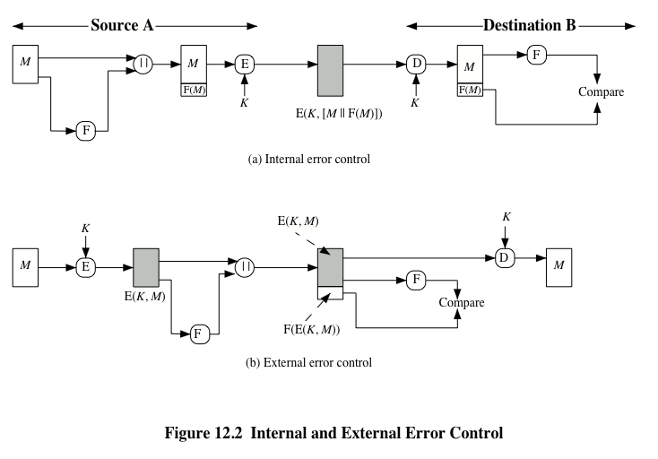
Notes:
It may be difficult to determine automatically if incoming ciphertext decrypts to intelligible plaintext. If the plaintext is, say, a binary object file or digitized
X-rays, determination of properly formed and therefore authentic plaintext may be difficult. Thus, an opponent could achieve a certain level of disruption simply by
issuing messages with random content purporting to come from a legitimate user.
One solution to this problem is to force the plaintext to have some structure that is easily recognized but that cannot be replicated without recourse to the encryption
function. We could, for example, append an error-detecting code, also known as a frame check sequence (FCS) or checksum, to each message before encryption,
as illustrated in Figure 12.2a. A prepares a plaintext message M and then provides this as input to a function F that produces an FCS. The FCS is appended to
M and the entire block is then encrypted. At the destination, B decrypts the incoming block and treats the results as a message with an appended FCS. B applies the
same function F to attempt to reproduce the FCS. If the calculated FCS is equal to the incoming FCS, then the message is considered authentic. It is unlikely that any
random sequence of bits would exhibit the desired relationship.
Note that the order in which the FCS and encryption functions are performed is critical. The sequence illustrated in Figure 12.2a is referred to in [DIFF79] as
internal error control , which the authors contrast with external error control (Figure 12.2b). With internal error control, authentication is provided because an
opponent would have difficulty generating ciphertext that, when decrypted, would have valid error control bits. If instead the FCS is the outer code, an opponent can
construct messages with valid error-control codes. Although the opponent cannot know what the decrypted plaintext will be, he or she can still hope to create confusion
and disrupt operations.

Slide 6
Public-Key Encryption
The straightforward use of public-key encryption provides confidentiality but not authentication
To provide both confidentiality and authentication, A can encrypt M first using its private key which provides the digital signature, and then using B’s public key, which provides confidentiality
Disadvantage is that the public-key algorithm must be exercised four times rather than two in each communication
Notes:
The straightforward use of public-key encryption (Figure 12.1b) provides confidentiality but not authentication. The source (A) uses
the public key PU_{b} of the destination (B) to encrypt M . Because only B has the corresponding private key PR_{b} , only B can decrypt the message. This scheme provides
no authentication, because any opponent could also use B’s public key to encrypt a message and claim to be A.
To provide authentication, A uses its private key to encrypt the message, and B uses A’s public key to decrypt (Figure 12.1c). This provides authentication using
the same type of reasoning as in the symmetric encryption case: The message must have come from A because A is the only party that possesses PR_{a} and therefore
the only party with the information necessary to construct ciphertext that can be decrypted with PU_{a} . Again, the same reasoning as before applies: There must be
some internal structure to the plaintext so that the receiver can distinguish between well-formed plaintext and random bits.
Assuming there is such structure, then the scheme of Figure 12.1c does provide authentication. It also provides what is known as digital signature. Only A
could have constructed the ciphertext because only A possesses PR_{a} . Not even B, the recipient, could have constructed the ciphertext. Therefore, if B is in possession
of the ciphertext, B has the means to prove that the message must have come from A. In effect, A has “signed” the message by using its private key to encrypt.
Note that this scheme does not provide confidentiality. Anyone in possession of A’s public key can decrypt the ciphertext.
To provide both confidentiality and authentication, A can encrypt M first using its private key, which provides the digital signature, and then using B’s public
key, which provides confidentiality (Figure 12.1d). The disadvantage of this approach is that the public-key algorithm, which is complex, must be exercised four
times rather than two in each communication.

Slide 7
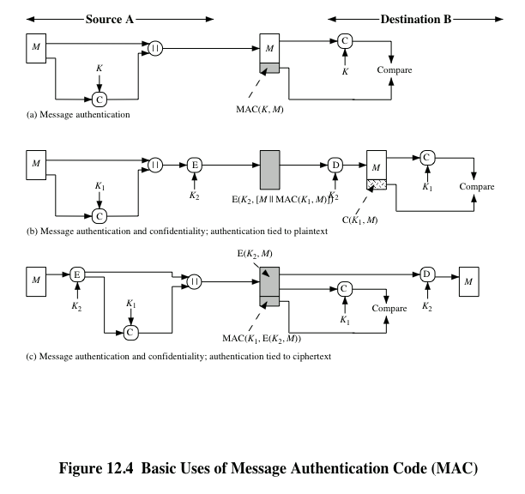
Notes:
An alternative authentication technique involves the use of a secret key to generate
a small fixed-size block of data, known as a cryptographic checksum or MAC, that is
appended to the message. This technique assumes that two communicating parties,
say A and B, share a common secret key K . When A has a message to send to B, it
calculates the MAC as a function of the message and the key:
MAC = C(K , M )
where
M = input message
C = MAC function
K = shared secret key
MAC = message authentication code
The message plus MAC are transmitted to the intended recipient. The recipient
performs the same calculation on the received message, using the same secret key,
to generate a new MAC. The received MAC is compared to the calculated MAC
(Figure 12.4a). If we assume that only the receiver and the sender know the identity
of the secret key, and if the received MAC matches the calculated MAC, then
1. The receiver is assured that the message has not been altered. If an attacker
alters the message but does not alter the MAC, then the receiver’s calculation
of the MAC will differ from the received MAC. Because the attacker is assumed
not to know the secret key, the attacker cannot alter the MAC to correspond
to the alterations in the message.
2. The receiver is assured that the message is from the alleged sender. Because
no one else knows the secret key, no one else could prepare a message with a
proper MAC.
3. If the message includes a sequence number (such as is used with HDLC, X.25,
and TCP), then the receiver can be assured of the proper sequence because an
attacker cannot successfully alter the sequence number.
A MAC function is similar to encryption. One difference is that the MAC
algorithm need not be reversible, as it must be for decryption. In general, the MAC
function is a many-to-one function. The domain of the function consists of messages
of some arbitrary length, whereas the range consists of all possible MACs and all
possible keys. If an n -bit MAC is used, then there are 2^{n} possible MACs, whereas
there are N possible messages with N >> 2^{n} . Furthermore, with a k -bit key, there
are 2^{k} possible keys.
The process depicted in Figure 12.4a provides authentication but not confidentiality,
because the message as a whole is transmitted in the clear. Confidentiality
can be provided by performing message encryption either after (Figure 12.4b) or
before (Figure 12.4c) the MAC algorithm. In both these cases, two separate keys are
needed, each of which is shared by the sender and the receiver. In the first case, the
MAC is calculated with the message as input and is then concatenated to the message.
The entire block is then encrypted. In the second case, the message is encrypted
first. Then the MAC is calculated using the resulting ciphertext and is concatenated
to the ciphertext to form the transmitted block. Typically, it is preferable to tie the
authentication directly to the plaintext, so the method of Figure 12.4b is used.

Slide 8
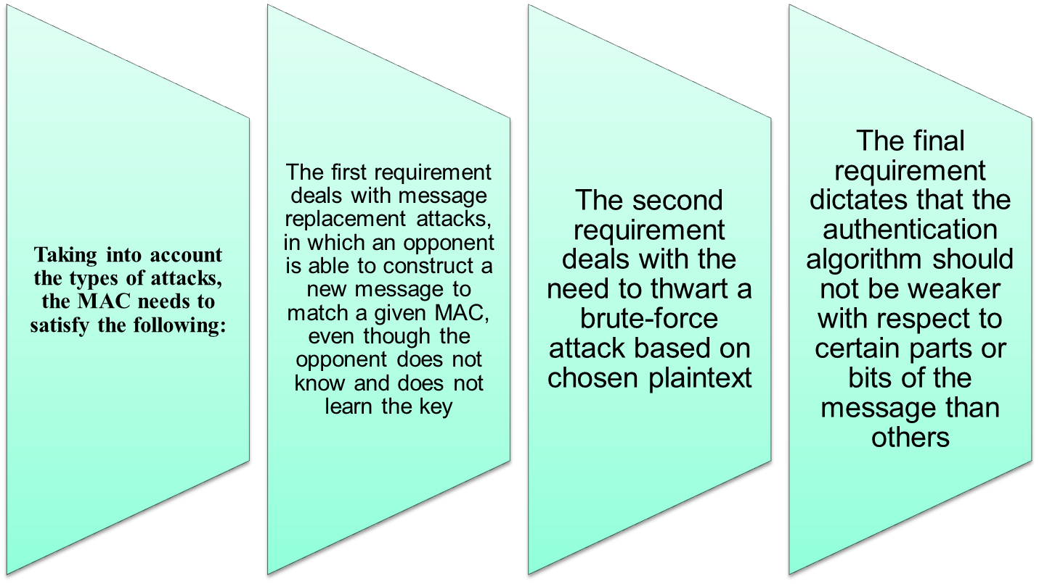
Requirements for MACs
Notes:
In assessing the security of a MAC function, we need to consider the types of attacks that may be mounted against it. Hence it needs to satisfy the listed requirements.
The first requirement deals with message replacement attacks, in which an opponent is able to construct a new message to match a given MAC, even though the opponent does not know and does not learn the key.
The second requirement deals with the need to thwart a brute-force attack based on chosen plaintext.
The final requirement dictates that the authentication algorithm should not be weaker with respect to certain parts or bits of the message than others.

Slide 9
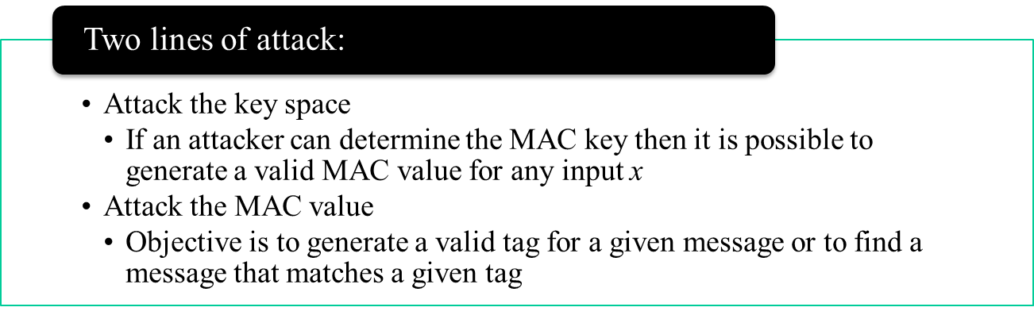
Brute-Force Attack
Requires known message-tag pairs
  A brute-force method of finding a collision is to pick a random bit string y and check if H(y) = H(x)
Notes:
A brute-force attack on a MAC is a more difficult undertaking than a brute-force
attack on a hash function because it requires known message-tag pairs. Let us see
why this is so. To attack a hash code, we can proceed in the following way. Given
a fixed message x with n -bit hash code h = H(x ), a brute-force method of finding
a collision is to pick a random bit string y and check if H(y ) = H(x ). The attacker
can do this repeatedly off line. Whether an off-line attack can be used on a MAC
algorithm depends on the relative size of the key and the tag.
The attacker would like to come up with the valid MAC code for a
given message x . There are two lines of attack possible: attack the key space and
attack the MAC value. We examine each of these in turn.
If an attacker can determine the MAC key, then it is possible to generate a
valid MAC value for any input x . Suppose the key size is k bits and that the attacker
has one known text-tag pair. Then the attacker can compute the n -bit tag on the
known text for all possible keys. At least one key is guaranteed to produce the correct
tag, namely, the valid key that was initially used to produce the known text-tag
pair. This phase of the attack takes a level of effort proportional to 2^{k} (that is, one
operation for each of the 2^{k} possible key values). However, as was described earlier,
because the MAC is a many-to-one mapping, there may be other keys that produce
the correct value. Thus, if more than one key is found to produce the correct value,
additional text-tag pairs must be tested. It can be shown that the level of effort
drops off rapidly with each additional text-MAC pair and that the overall level of
effort is roughly 2^{k} [MENE97].
An attacker can also work on the tag without attempting to recover the key.
Here, the objective is to generate a valid tag for a given message or to find a message
that matches a given tag. In either case, the level of effort is comparable to that for
attacking the one-way or weak collision-resistant property of a hash code, or 2^{n} . In
the case of the MAC, the attack cannot be conducted off line without further input;
the attacker will require chosen text-tag pairs or knowledge of the key.
To summarize, the level of effort for brute-force attack on a MAC algorithm
can be expressed as min(2^{k} , 2^{n} ). The assessment of strength is similar to that for
symmetric encryption algorithms. It would appear reasonable to require that the
key length and tag length satisfy a relationship such as min(k , n) ≥ N , where N is
perhaps in the range of 128 bits.

Slide 10
Keyed-hash Message Authentication Code (HMAC)
want a MAC based on a hash function
  because hash functions are generally faster
  code for crypto hash functions widely available
hash includes a key along with message
original proposal:
  KeyedHash = Hash(Key|Message)
  some weaknesses were found with this
eventually led to development of HMAC
CEG 260, Meilin Liu
Notes:
Zili Shao
In recent years, there has been increased interest in developing a MAC derived from a cryptographic hash function. A hash function such as SHA was not designed for use as a MAC and cannot be used directly for that purpose because it does not rely on a secret key. There have been a number of proposals for the incorporation of a secret key into an existing hash algorithm, originally by just pre-pending a key to the message. Problems were found with these earlier, simpler proposals, but they resulted in the development of HMAC.

Slide 11
HMAC
specified as Internet standard RFC2104
uses hash function on the message:
  HMAC_{K} = Hash[(K⁺ XOR opad) ||
  Hash[(K⁺ XOR ipad)||M)]]
where K⁺ is the key padded out to block size (b bits)
opad, ipad are specified padding constants
  ipad:00110110(36 in hexidecimal) repeated by b/8 times
  opad:01011100(5C in hexidecimal) repeated by b/8 times
overhead is just 3 more hash calculations than the message needs alone
any hash function can be used
  eg. MD5, SHA-1, RIPEMD-160, Whirlpool
CEG 260, Meilin Liu
Notes:
Zili Shao
The idea of a keyed hash evolved into HMAC, designed to overcome some problems with the original proposals. It involves hashing padded versions of the key concatenated with the message, and then with another outer hash of the result prepended by another padded variant of the key. The hash function need only be used on 3 more blocks than when hashing just the original message (for the two keys + inner hash). HMAC can use any desired hash function, and has been shown to have the same security as the underlying hash function. Can choose the hash function to use based on speed/security concerns.

Slide 12
HMAC
the HMAC algorithm:
Append zeros to the end of K to create a b-bit string (e.g., if K is of length 160 bits, and b = 1024 bits, then K will be appended with 864 bits of zeros to the end of K).
XOR (bitwise exclusive-or ) with ipad to produce b-bit block Si.
Append input message M to Si.
Apply hash to the stream generated in step 3.
XOR (bitwise exclusive-or ) the b bit string computed in step 1 with opad to produce the b-bit block So.
Append the hash output from step 4 to So.
Apply hash to the stream generated in step 6 to produce the output of HMAC.
CEG 260, Meilin Liu
Notes:
Zili Shao
The idea of a keyed hash evolved into HMAC, designed to overcome some problems with the original proposals. It involves hashing padded versions of the key concatenated with the message, and then with another outer hash of the result prepended by another padded variant of the key. The hash function need only be used on 3 more blocks than when hashing just the original message (for the two keys + inner hash). HMAC can use any desired hash function, and has been shown to have the same security as the underlying hash function. Can choose the hash function to use based on speed/security concerns.

Slide 13
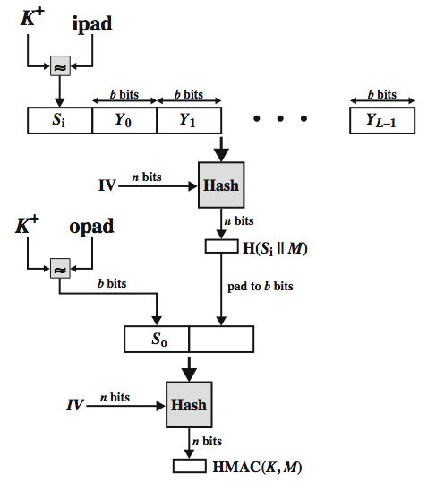
HMAC Overview
CEG 260, Meilin Liu
Notes:
Zili Shao
Stallings Figure 12.10 shows the structure of HMAC, which implements the function:
HMAC_{K} = Hash[(K⁺ XOR opad) || Hash[(K⁺ XOR ipad) || M)]
elements are:
K⁺ is K padded with zeros on the left so that the result is b bits in length
ipad is a pad value of 36 hex repeated to fill block
opad is a pad value of 5C hex repeated to fill block
M is the message input to HMAC (including the padding specified in the embedded hash function)

Slide 14
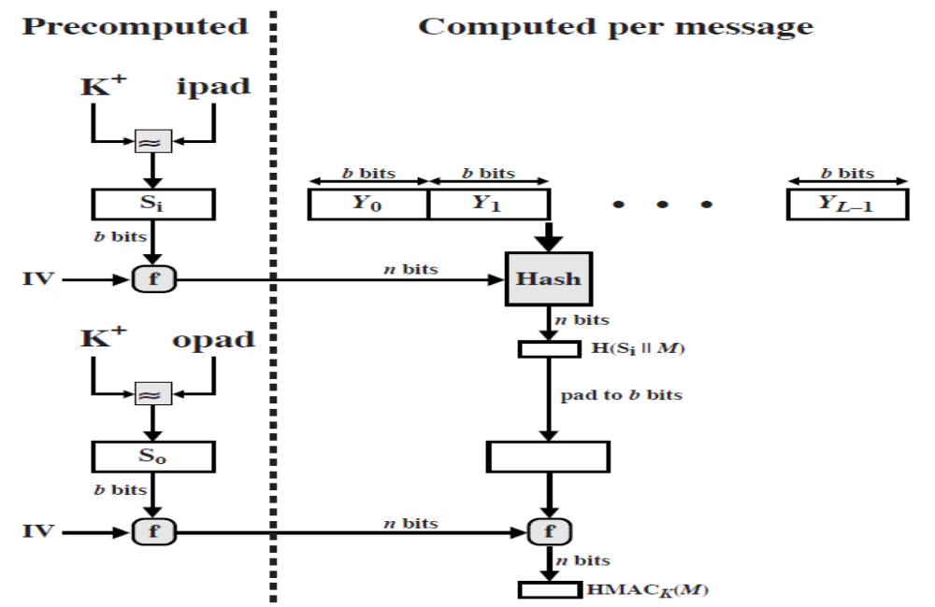
Efficient Implementation of HMAC
CEG 260, Meilin Liu
Notes:
Zili Shao
TLS (Transport Layer Security): CBC AES-128, HMAC-(SHA-1)-96
Stallings Figure 12.10 shows the structure of HMAC, which implements the function:
HMAC_{K} = Hash[(K⁺ XOR opad) || Hash[(K⁺ XOR ipad) || M)]
elements are:
K⁺ is K padded with zeros on the right so that the result is b bits in length
ipad is a pad value of 36 hex repeated to fill block
opad is a pad value of 5C hex repeated to fill block
M is the message input to HMAC (including the padding specified in the embedded hash function)

Slide 15
HMAC Security
proved security of HMAC relates to that of the underlying hash algorithm
attacking HMAC requires either:
  brute force attack on key used
  birthday attack (but since keyed would need to observe a very large number of messages)
choose hash function used based on speed verses security constraints
CEG 260, Meilin Liu
Notes:
Zili Shao
TLS (Transport Layer Security): CBC AES-128, HMAC-(SHA-1)-96
The appeal of HMAC is that its designers have been able to prove an exact relationship between the strength of the embedded hash function and the strength of HMAC. The security of a MAC function is generally expressed in terms of the probability of successful forgery with a given amount of time spent by the forger and a given number of message-MAC pairs created with the same key. Have two classes of attacks: brute force attack on key used which has work of order 2^n; or a birthday attack which requires work of order 2^(n/2) - but which requires the attacker to observe 2^n blocks of messages using the same key - very unlikely. So even MD5 is still secure for use in HMAC given these constraints.

Slide 16
Using Symmetric Ciphers for MACs
can use any block cipher chaining mode and use final block as a MAC
Data Authentication Algorithm (DAA) is a widely used MAC based on DES-CBC
  using IV=0 and zero-pad of final block
  encrypt message using DES in CBC mode
  and send just the final block as the MAC
    or the leftmost M bits (16≤M≤64) of final block
but final MAC is now too small for security
Notes:
In this section, we look at two MACs that are based on the use of a block cipher mode of operation. We begin with an older algorithm, the Data Authentication Algorithm (DAA), a widely used though now obsolete MAC based on DES-CBC (next slide). However this suffers from being too small for acceptable use today.
Raw-CBC MAC is susceptible to length extension attacks.

Slide 17
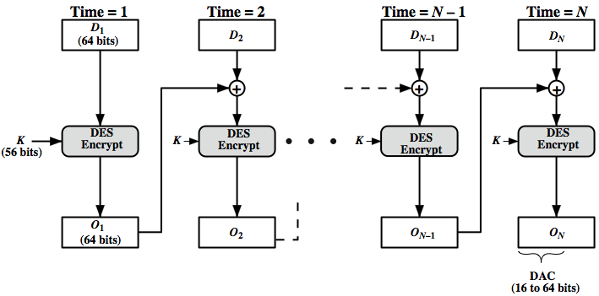
Data Authentication Algorithm
Notes:
Raw-CBC MAC is susceptible to length extension attacks.
The Data Authentication Algorithm, based on DES, has been one of the most widely used MACs for a number of years. The algorithm is both a FIPS publication (FIPS PUB 113) and an ANSI standard (X9.17). However, security weaknesses in this algorithm have been discovered and it is being replaced by newer and stronger algorithms. The algorithm is shown here in Stallings Figure 12.7, and can be defined as using the cipher block chaining (CBC) mode of operation of DES, with an initialization vector of zero, and 0-pad of the final block if needed. Resulting MAC can be 16-64 bits of the final block. But this is now too small for security.

Slide 18
CMAC
previously saw the DAA (CBC-MAC)
widely used in govt & industry
but has message size limitation
can overcome using 2 keys & padding
thus forming the Cipher-based Message Authentication Code (CMAC)
adopted by NIST SP800-38B
Notes:
The Data Authentication Algorithm cipher-based MAC has been widely adopted in government and industry. Has been shown to be secure, with the following restriction. Only messages of one fixed length of mn bits are processed, where n is the cipher block size and m is a fixed positive integer. This limitation can be overcome using multiple keys, which can be derived from a single key. This refinement has been adopted by NIST as the cipher-based message authentication code (CMAC) mode of operation, for use with AES and triple DES. It is specified in NIST Special Publication 800-38B.

Slide 19
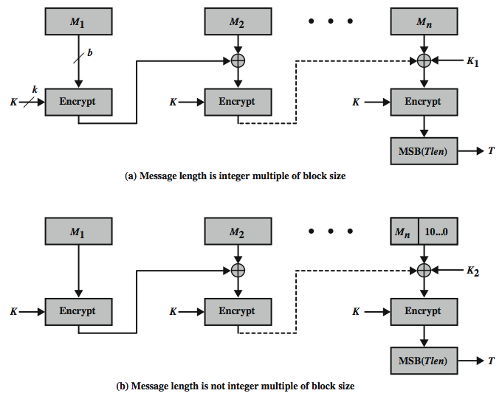
CMAC Overview
Notes:
Stallings Figure 12.8 shows the structure of CMAC. It uses the blocksize of the underlying cipher (ie 128-bits for AES or 64-bits for triple-DES). The message is divided into n blocks M1..Mn, padded if necessary. The algorithm makes use of a k-bit encryption key K and an n-bit constant K1 or K2 (depending on whether the message was padded or not). For AES, the key size k is 128,192, or 256 bits; for triple DES, the key size is 112 or 168 bits. The two constants K1 & K2 are derived from the original key K using encryption of 0 and multiplication in GF(2^n), as detailed in the text.

Slide 20
CMAC
K1, K2 derivation:
L = E(K, 0^b)
K1 = L * x
K2 = L * x^2 = (L*x)* x
The prime polynomials are x^64 +x^4 + x^3 + x +1 or x^128 +x^7 + x^2 + x +1
Notes:
The Data Authentication Algorithm cipher-based MAC has been widely adopted in government and industry. Has been shown to be secure, with the following restriction. Only messages of one fixed length of mn bits are processed, where n is the cipher block size and m is a fixed positive integer. This limitation can be overcome using multiple keys, which can be derived from a single key. This refinement has been adopted by NIST as the cipher-based message authentication code (CMAC) mode of operation, for use with AES and triple DES. It is specified in NIST Special Publication 800-38B.

Slide 21
Summary
have considered:
  HMAC authentication using hash function
  CMAC authentication using a block cipher
CEG 260, Meilin Liu
Notes:
Zili Shao
Chapter 12 summary.

Slide 22
Authenticated Encryption (AE)
A term used to describe encryption systems that simultaneously protect confidentiality and authenticity of communications
Approaches:
  Hash-then-encrypt: E(K, (M || h))
  MAC-then-encrypt: T = MAC(K₁, M), E(K₂, [M || T])
  Encrypt-then-MAC: C = E(K₂, M), T = MAC(K₁, C)
  Encrypt-and-MAC: C = E(K₂, M), T = MAC(K₁, M)
Both decryption and verification are straightforward for each approach
There are security vulnerabilities with all of these approaches
Notes:
Authenticated encryption (AE) is a term used to describe encryption systems that
simultaneously protect confidentiality and authenticity (integrity) of communications.
Many applications and protocols require both forms of security, but until recently
the two services have been designed separately.
[BLAC05] discussed four common approaches to providing both confidentiality
and encryption for a message M .
• HtE: Hash-then-encrypt. First compute the cryptographic hash function over
M as h = H (M ). Then encrypt the message plus hash function: E(K , (M ||h )).
• MtE: MAC-then-encrypt. Use two keys. First authenticate the plaintext by
computing the MAC value as T = MAC(K₁ , M ). Then encrypt the message
plus tag: E(K₂ , [M}T ]). This approach is taken by the SSL/TLS protocols
(Chapter 17).
• EtM: Encrypt-then-MAC. Use two keys. First encrypt the message to
yield the ciphertext C = E(K₂ , M ). Then authenticate the ciphertext with
T = MAC(K₁ , C ) to yield the pair (C , T ). This approach is used in the IPsec
protocol (Chapter 20).
• E&M: Encrypt-and-MAC. Use two keys. Encrypt the message to yield the ciphertext
C = E(K₂ , M ). Authenticate the plaintext with T = MAC(K₁ , M ) to
yield the pair (C , T ). These operations can be performed in either order. This
approach is used by the SSH protocol (Chapter 17).
Both decryption and verification are straightforward for each approach. For
HtE, MtE, and E&M, decrypt first, then verify. For EtM, verify first, then decrypt.
There are security vulnerabilities with all of these approaches. The HtE approach
is used in the Wired Equivalent Privacy (WEP) protocol to protect WiFi networks.
This approach had fundamental weaknesses and led to the replacement of the WEP
protocol. [BLAC05] and [BELL00] point out that there are security concerns in
each of the three encryption/MAC approaches listed above. Nevertheless, with
proper design, any of these approaches can provide a high level of security. This is
the goal of the two approaches discussed in this section, both of which have been
standardized by NIST.

Slide 23

… but first, some history
Authenticated Encryption (AE): introduced in 2000 [KY’00, BN’00]
Crypto APIs before then: (e.g. MS-CAPI)
Provide API for CPA-secure encryption (e.g. CBC with rand. IV)
Provide API for MAC (e.g. HMAC)
Every project had to combine the two itself without
a well defined goal
Not all combinations provide AE …

Slide 24
Combining MAC and ENC (CCA)
Encryption key k_{E}. MAC key = k_{I}
Option 1: (SSL)
Option 2: (IPsec)
Option 3: (SSH)
S(k_{I}, m)
E(k_{E} , mlltag)
msg m
msg m
tag
E(k_{E}, m)
S(k_{I}, c)
always
correct
msg m
tag
E(k_{E} , m)
S(k_{I}, m)
msg m
tag

Slide 25
Authenticated Encryption (AE)
A term used to describe encryption systems that simultaneously protect confidentiality and authenticity of communications
Approaches:
  Hash-then-encrypt: E(K, (M || h))
  MAC-then-encrypt: T = MAC(K₁, M), E(K₂, [M || T])
  Encrypt-then-MAC: C = E(K₂, M), T = MAC(K₁, C)
  Encrypt-and-MAC: C = E(K₂, M), T = MAC(K₁, M)
Both decryption and verification are straightforward for each approach
There are security vulnerabilities with all of these approaches
Notes:
Authenticated encryption (AE) is a term used to describe encryption systems that
simultaneously protect confidentiality and authenticity (integrity) of communications.
Many applications and protocols require both forms of security, but until recently
the two services have been designed separately.
[BLAC05] discussed four common approaches to providing both confidentiality
and encryption for a message M .
• HtE: Hash-then-encrypt. First compute the cryptographic hash function over
M as h = H (M ). Then encrypt the message plus hash function: E(K , (M ||h )).
• MtE: MAC-then-encrypt. Use two keys. First authenticate the plaintext by
computing the MAC value as T = MAC(K₁ , M ). Then encrypt the message
plus tag: E(K₂ , [M}T ]). This approach is taken by the SSL/TLS protocols
(Chapter 17).
• EtM: Encrypt-then-MAC. Use two keys. First encrypt the message to
yield the ciphertext C = E(K₂ , M ). Then authenticate the ciphertext with
T = MAC(K₁ , C ) to yield the pair (C , T ). This approach is used in the IPsec
protocol (Chapter 20).
• E&M: Encrypt-and-MAC. Use two keys. Encrypt the message to yield the ciphertext
C = E(K₂ , M ). Authenticate the plaintext with T = MAC(K₁ , M ) to
yield the pair (C , T ). These operations can be performed in either order. This
approach is used by the SSH protocol (Chapter 17).
Both decryption and verification are straightforward for each approach. For
HtE, MtE, and E&M, decrypt first, then verify. For EtM, verify first, then decrypt.
There are security vulnerabilities with all of these approaches. The HtE approach
is used in the Wired Equivalent Privacy (WEP) protocol to protect WiFi networks.
This approach had fundamental weaknesses and led to the replacement of the WEP
protocol. [BLAC05] and [BELL00] point out that there are security concerns in
each of the three encryption/MAC approaches listed above. Nevertheless, with
proper design, any of these approaches can provide a high level of security. This is
the goal of the two approaches discussed in this section, both of which have been
standardized by NIST.

Slide 26
A.E. Theorems
Let (E,D) be CPA secure cipher and (S,V) secure MAC. Then:
Encrypt-then-MAC: always provides A.E.
MAC-then-encrypt: may be insecure against CCA attacks
however: when (E,D) is rand-CTR mode or rand-CBC
M-then-E provides A.E.
for rand-CTR mode, one-time MAC is sufficient

Slide 27
Authenticated Encryption (AE)
Let (E,D) be a cipher and (S,V) be a secure MAC. Then:
Encrypt-then-MAC: always provides Authenticated Encryption.
MAC-then-encrypt: may be insecure against CCA (chosen Cipher Attacks) attacks
however: when (E,D) is rand-CTR mode or rand-CBC M-then-E provides Authenticated Encryption
For rand-CTR mode, one-time MAC is sufficient
Notes:
(S, V): (Sign, Verification).
Zili Shao

